Slide 1

Interactive Systems Research Center

Slide 2
The Mission
Across Campus…
The ISRC acts as a bridge for faculty across the UMBC campus with expertise in designing, building, or studying uses of interactive computing systems.
It facilitates the sharing of resources and experience in solving computing problems from a user-centered perspective grounded in user needs and not in simply applying previously designed solutions to new domains.

Slide 3
The Mission
Throughout the region…
The ISRC also acts as a bridge to industry, community, and organizations in order to foster long-standing relationships in addressing user needs through interactive computing solutions.
Through the center, external collaborators can seamlessly work with a mix of expertise to innovate interactive computing solutions of societal importance.

Slide 4
Building a Team
Leveraging current, past, and near future externally-funded collaborative projects
Information Systems (9)
Computer Science (9)
Visual Arts / IRC (6)
Erickson
Psychology
Sociology/anthropology
Mechanical Engineering
New Media Studio

Slide 5
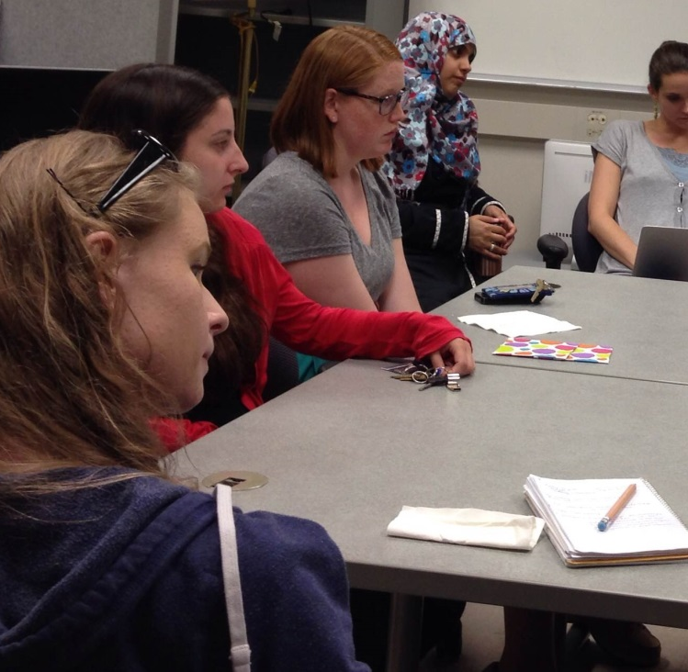
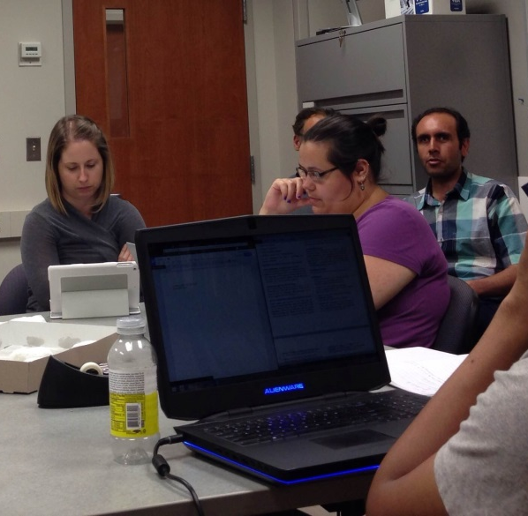
Fostering Community

Slide 6


